Slide 1
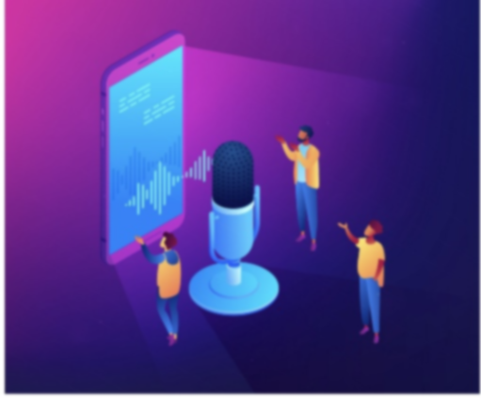
JARVIS VOICE ASSISTANT
MINOR PROJECT

Slide 2
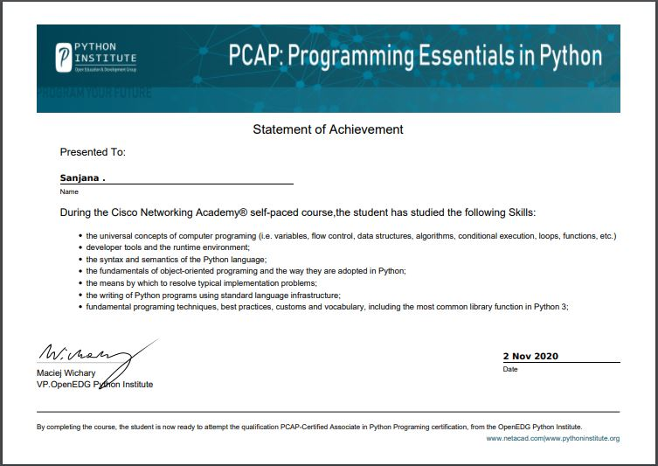
CERTIFICATE

Slide 3
ACKNOWLEDGEMENT
I have given my efforts in this project. However, it would not have been possible without the kind cooperation and support of my teachers and partner. I would like to express my deepest appreciation to all those who provided me the possibility to complete this report.
A special gratitude to my mentor Mr. Abhishek Gaur and Mr. J.P. Soja sir whose contribution in stimulating suggestions and encouragement, helped me to coordinate my project especially in writing this report. And also, I would like to extend my sincere thanks to all of them who guided us well in completing this project.
Furthermore, this project report makes me realized that working as individually gives me new experiences to work in, which challenges me every single minute.

Slide 4
ABSTRACT
It is named as Personal Assistant with Voice Recognition Intelligence, which takes the user input in form of voice and process it and returns the output in various forms like action to be performed or the search result is dictated to the end user. In addition, this proposed system can change the way of interactions between end user and the devices. The system is being designed in such a way that all the services provided by the devices are accessible by the end user on the user's voice commands.

Slide 5
INTRODUCTION
It will also discuss some of the privacy and security issues inherent with voice assistants and potential future uses for these devices. As voice assistants are more widely used, librarians will want to become familiar with the technology, which has the potential to be a delivery mechanism for library materials and services.

Slide 6
AIM & PURPOSE
According to the overall description in the context, the purpose of the project is to develop an
intelligent voice assistant with the functionalities as mail exchange, alarm, music play service, searching engine (Google, Wikipedia), opening command prompt, opening pdf reader, opening YouTube, camera, Bluetooth headset support, etc.
This project is focusing on the Intelligence Voice Assistant over the voice control (recognition, generate and analyze corresponding commands, intelligent responses automatically), Google products and relevant APIs (Google map, Google weather, Google search and etc), Wikipedia API and mobile device references ranging from Speech-To-Text, Text-To-Speech technology, Bluetooth headset support and camera; Multi-threading. As all those functionalities and services for the project have been explained, the main structure and construction of the project has been basically illustrated with its goals.

Slide 7
WHAT ARE VOICE ASSISTANTS ?
Simply put, voice assistants are the realization of the science fiction dream of interacting with our computers by talking to them. Apple’s Siri, Microsoft’s Cortana, Amazon’s Alexa, and Google’s Assistant are all software agents that run on purpose-built speaker devices or smartphones. The software constantly listens for a key word to wake it up. Once it hears that key word, it records the user’s voice and sends it to specialized server, which processes and interprets it as a command. Depending on the command, the server will supply the voice assistant with appropriate information to be read back to the user, play the media requested by the user, or complete tasks with various connected services and devices.

Slide 8
WHAT CAN VOICE ASSISTANTS DO?
Amazon’s Alexa has skills for playing Jeopardy, ordering your usual drink from your local Starbucks, and summoning an Uber or Lyft using connected account data. Google’s Assistant has similar skills but lags behind Amazon in the sheer number of available skills, largely due to being released later.2 These skills are built by third-party developers, similar to the way apps are developed for smartphones. Google Assistant also integrates with several tools that allow users to create their own skills.

Slide 9
FUNCTIONING
Calling service,
Mail exchange
Alarm,
Music player service,
Google searching engine
Wikipedia searching engine,
Robot chat
Camera

Slide 10
Sample SOURCE CODE
import pyttsx3
import speech_recognition as sr
import datetime
import cv2
import random
import wikipedia
import pychrome
import webbrowser
import os
import smtplib
import sys
import pyjokes
engine = pyttsx3.init('sapi5')
voices = engine.getProperty('voices')
engine.setProperty('voice', voices[0].id)
#text to speech
def speak(audio):
engine.say(audio)

Slide 11
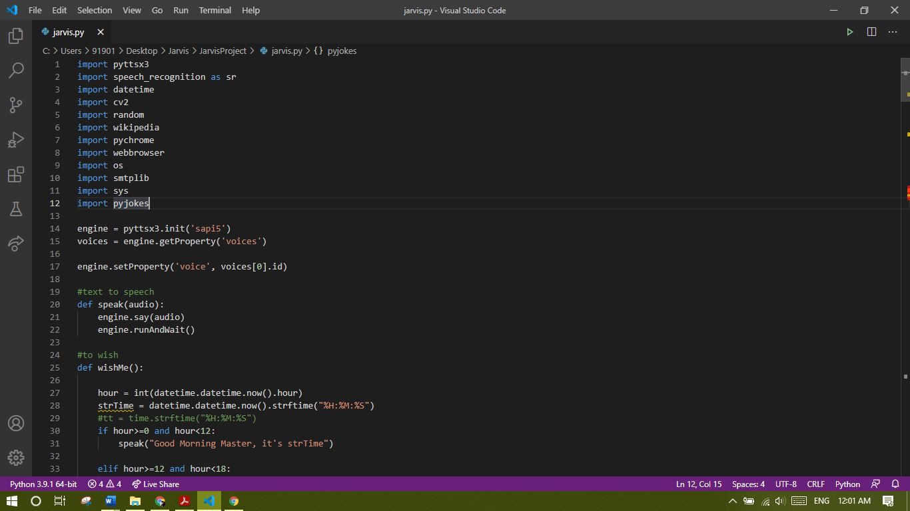
Output

Slide 12
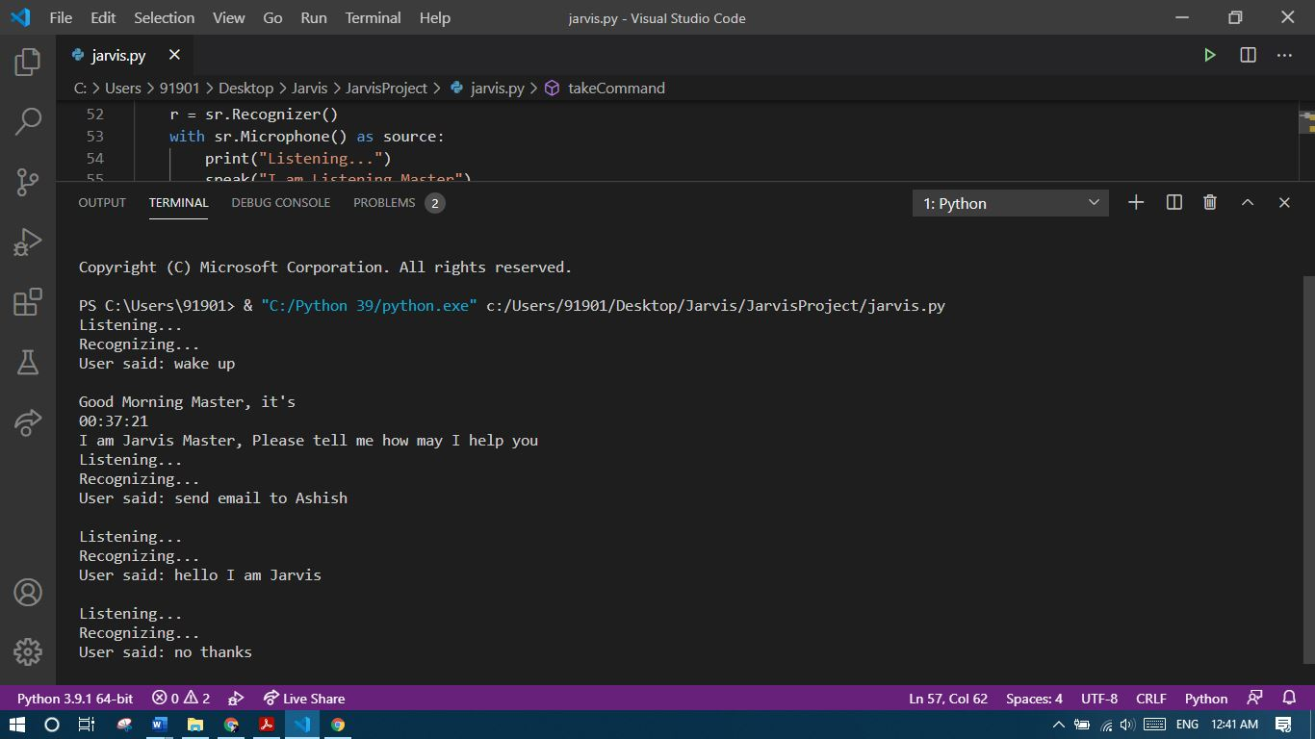

Slide 13
CONCLUSION
The complexity and accuracy of voice recognition technology and voice assistant software have grown exponentially in the last few years. Currently available voice assistant products from Apple, Amazon, Google, and 86 M. B. HOY Microsoft allow users to ask questions and issue commands to computers in natural language. There are many possible future uses of this technology, from home automation to translation to companionship and support for the elderly. However, there are also several problems with the currently available voice assistant products. Privacy and security controls will need to be improved before voice assistants should be used for anything that requires confidentiality. Librarians should monitor these products and be ready to provide assistance to their patrons with these devices. They should also explore the possibilities for providing library materials via voice assistants as the technology matures.

